Slide 1

Navigating the Future of Online Shopping
Target Dataset Analysis using SQL & Python
By analyzing sales distribution across product categories,
I have uncovered meaningful patterns in customer preferences & revenue drivers. These insights empower smarter inventory decisions and more targeted marketing efforts.
Presented by: Lopita Mishra

Slide 2
Objective
Our analysis aims to unlock valuable insights from comprehensive ecommerce datasets, examining customer behaviour, order patterns, and product performance.
Extract actionable insights from customer, order, product, and seller datasets
Analyse sales trends, order patterns, and customer behaviour dynamics
Visualise key metrics to support data-driven decision-making and strategic planning

Slide 3
Data Overview
Our comprehensive analysis draws from seven interconnected datasets, providing a 360-degree view of the ecommerce ecosystem.
Dataset
Records
Key Columns
Customers
99,441
customer_id, city, state
Orders
99,441
order_id, customer_id, timestamps
Order Items
112,650
order_id, product_id, seller_id, price
Payments
103,886
order_id, payment_type, installments, value
Sellers
3,095
seller_id, city, state
Products
32,951
product_id, category, price
Geolocation
1,000,163
zip_code, lat, lng, city, state

Slide 4
Basic Insights
Customer Distribution
2017 Order Volume
Analysis reveals customers spread across numerous unique cities throughout World, indicating widespread market penetration and diverse geographical reach.
A robust 45,101 orders were processed in 2017, demonstrating strong platform engagement and sustained customer activity throughout the year.
Payment Flexibility
Significant portion of customers opted for installment-based payments, reflecting the importance of flexible payment options in driving conversions.
All analytical questions were addressed through SQL queries, and the results were visualized using Python for better insight representation.
Solved Questions

Slide 5
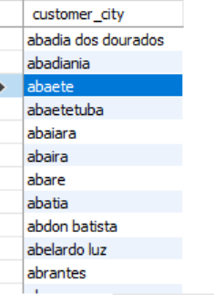
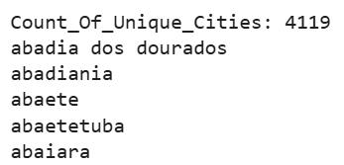
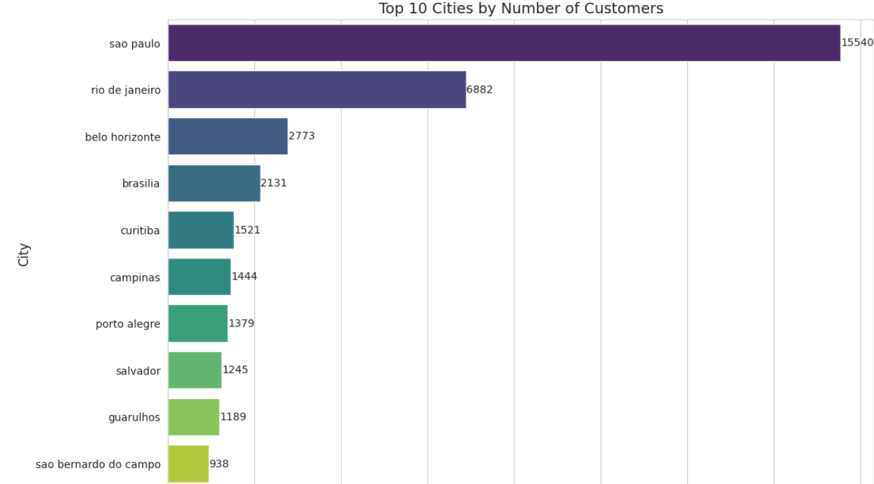
Q1. Unique Cities Where Customers Are Located
SQL Query:
SELECT DISTINCT customer_city
FROM customers
WHERE customer_city IS NOT NULL AND TRIM(customer_city) <> ‘ ’
ORDER BY customer_city;
Output
Python Code:
Count_Of_Unique_Cities= customers['customer_city'].nunique()
print("Count_Of_Unique_Cities:" ,Count_Of_Unique_Cities)
unique_cities = sorted(customers['customer_city'].dropna().unique())
for city in unique_cities:
print(city)
Output
city_counts = customers['customer_city'].value_counts().reset_index()
city_counts.columns = ['City', 'Customer_Count']
top_cities = city_counts.head(20)
plt.figure(figsize=(12,8))
ax = sns.barplot(x='Customer_Count', y='City', data=top_cities, palette='viridis')
plt.title('Top 20 Cities by Number of Customers', fontsize=14)
plt.xlabel('Number of Customers', fontsize=12)
plt.ylabel('City', fontsize=12)
for i, (count, city) in enumerate(zip(top_cities['Customer_Count'], top_cities['City'])):
ax.text(count + 10, i, f'{count}', va='center', fontsize=10)
plt.show()
Output
Insight: Customers are spread across more than 4000 cities, showing diverse market reach, Sao Paulo has highest no. of Customers i.e 15540.

Slide 6
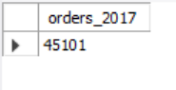
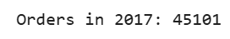
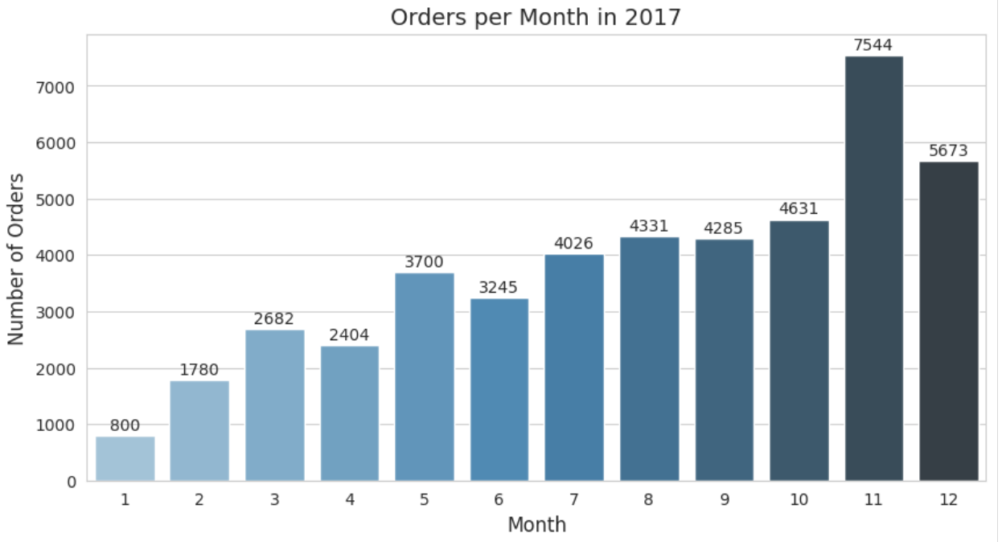
Q2. Total Orders Placed in 2017
SQL Query:
SELECT COUNT(*) AS orders_2017
FROM orders
WHERE order_purchase_timestamp IS NOT NULL AND STR_TO_DATE(order_purchase_timestamp, '%Y-%m-%d %H:%i:%s') IS NOT NULL AND YEAR(STR_TO_DATE(order_purchase_timestamp, '%Y-%m-%d %H:%i:%s')) = 2017;
Output
Python Code:
orders_2017 = orders[orders['order_purchase_timestamp'].dt.year == 2017]
print("Orders in 2017:", orders_2017.shape[0])
Output
orders_2017 = orders[orders['order_purchase_timestamp'].dt.year == 2017]
print("Orders in 2017:", orders_2017.shape[0])
orders_2017 = orders[orders['order_purchase_timestamp'].dt.year == 2017]
orders_per_month = orders_2017.groupby(orders_2017['order_purchase_timestamp'].dt.month).size().reset_index(name='orders')
orders_per_month.rename(columns={'order_purchase_timestamp':'month'}, inplace=True)
plt.figure(figsize=(10,5))
ax = sns.barplot(x='month', y='orders', data=orders_per_month, palette='Blues_d')
plt.title('Orders per Month in 2017', fontsize=14)
plt.xlabel('Month', fontsize=12)
plt.ylabel('Number of Orders', fontsize=12)
for i, row in orders_per_month.iterrows():
ax.text(i, row['orders'] + 100, f"{row['orders']}", ha='center', fontsize=10)
plt.show()
Output
Insight: High volume of orders in November 2017(7544) indicates a strong dataset for order behavior analysis with a total orders of 45101 for 2017.

Slide 7
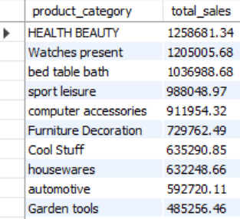
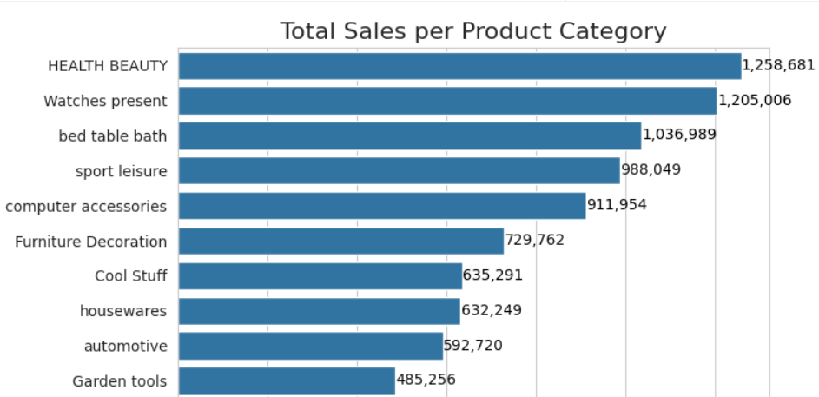
Q3. Total Sales per Product Category
SQL Query:
SELECT p.product_category,
ROUND(SUM(oi.price),2) AS total_sales
FROM order_items oi
JOIN products p ON oi.product_id = p.product_id
GROUP BY p.product_category
ORDER BY total_sales DESC;
Output
Python Code:
merged = order_items.merge(products, on='product_id', how='left')
sales_category = (
merged.groupby('product category')['price']
.sum()
.reset_index()
.sort_values(by='price', ascending=False))
plt.figure(figsize=(16, 20))
ax = sns.barplot(x='price', y='product category', data=sales_category, orient='h')
plt.title('Total Sales per Product Category', fontsize=16)
plt.xlabel('Total Sales (USD)', fontsize=12)
plt.ylabel('Product Category', fontsize=12)
for i, v in enumerate(sales_category['price']):
ax.text(v + 500, i, f'{v:,.0f}', color='black', va='center', fontsize=10)
plt.tight_layout()
plt.show()
Output
Insight: This value represents the company’s overall revenue and Health Beauty Category has highest sales Of ‘1,258,681'

Slide 8
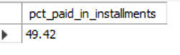
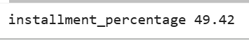
Q4. Percentage of Orders Paid in Installments
SQL Query:
SELECT
ROUND(100 * SUM(CASE
WHEN payment_installments > 1 THEN 1
ELSE 0
END) / COUNT(*),
2) AS pct_paid_in_installments
FROM payments;
Output
Python Code:
installment_percentage = round((payments['payment_installments'] > 1).sum() / len(payments) * 100, 2)
Print(“installment_percentage”, installment_percentage )
Output
Insight: Over one-third of all transactions (42.42%) were made using installment payments.

Slide 9
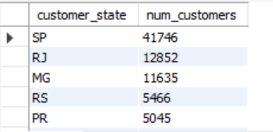
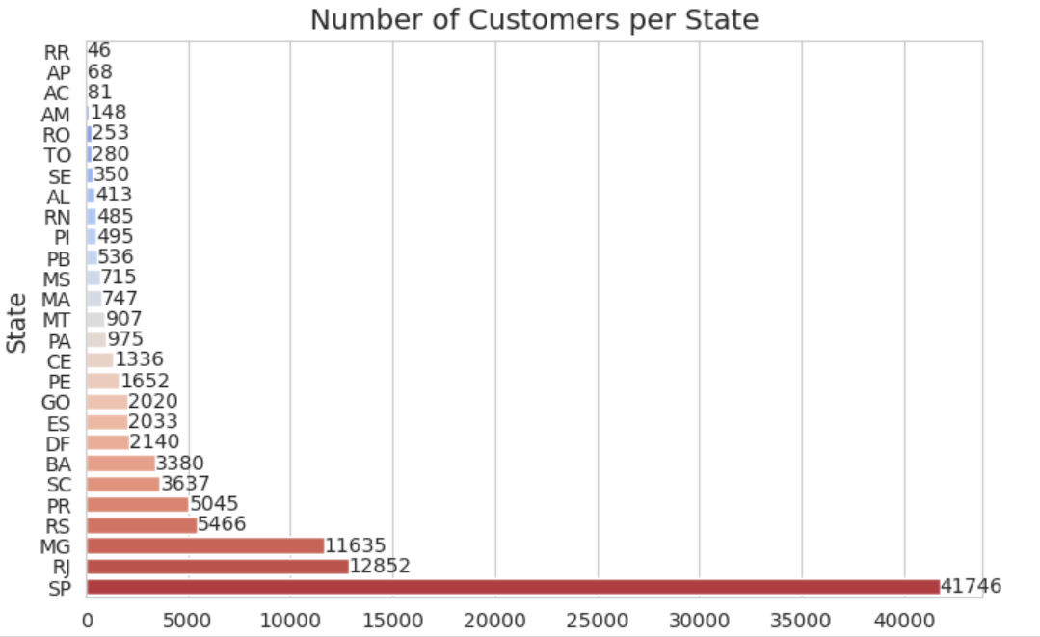
Q5. Number of Customers per State
SQL Query:
SELECT customer_state, COUNT(*) AS num_customers
FROM customers
GROUP BY customer_state
ORDER BY num_customers DESC;
Output
Python Code:
cust_per_state = customers['customer_state'].value_counts().reset_index()
cust_per_state.columns = ['State', 'Customer_Count’]
cust_per_state = cust_per_state.sort_values(by='Customer_Count', ascending=True)
plt.figure(figsize=(12,8))
ax = sns.barplot(x='Customer_Count', y='State', data=cust_per_state, palette='coolwarm')
plt.title('Number of Customers per State', fontsize=14)
plt.xlabel('Number of Customers', fontsize=12)
plt.ylabel('State', fontsize=12)
for i, (count, state) in enumerate(zip(cust_per_state['Customer_Count'], cust_per_state['State'])):
ax.text(count + 5, i, f'{count}', va='center', fontsize=10)
plt.show()
Output
Insight: São Paulo (SP), Rio de Janeiro (RJ), and Minas Gerais (MG) have the most customers.

Slide 10
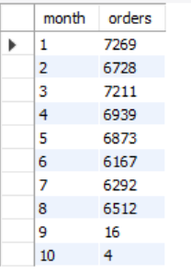
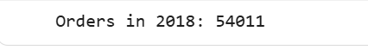
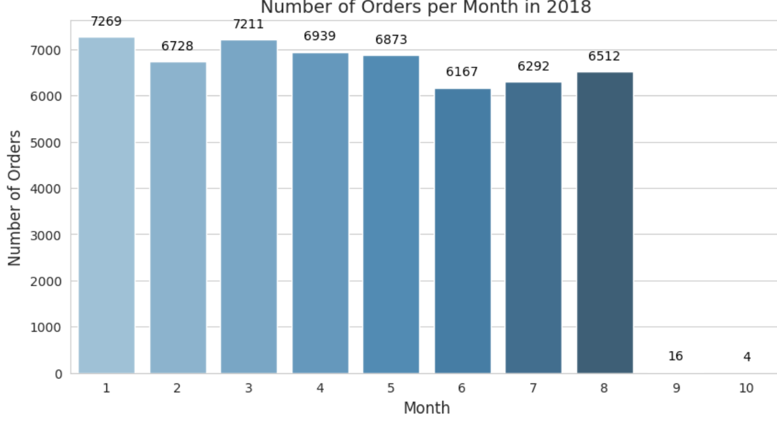
Q6. Orders per Month in 2018
SQL Query:
SELECT MONTH(dt) AS month,
COUNT(*) AS orders
FROM ( SELECT order_id, STR_TO_DATE(order_purchase_timestamp,
'%Y-%m-%d %H:%i:%s') AS dt
FROM orders) t
WHERE YEAR(dt) = 2018
GROUP BY MONTH(dt)
ORDER BY MONTH(dt);
Output
Python Code:
orders_2018 = orders[orders['order_purchase_timestamp'].dt.year == 2018]
print("Orders in 2018:", orders_2018.shape[0])
Output
orders_2018 = orders[orders['order_purchase_timestamp'].dt.year == 2018]
orders_month = (
orders_2018.groupby(orders_2018['order_purchase_timestamp'].dt.month).size()
.reset_index(name='Orders'))
orders_month.columns = ['Month', 'Orders']
plt.figure(figsize=(10, 5))
ax = sns.barplot(x='Month', y='Orders', data=orders_month, palette='Blues_d')
plt.title('Number of Orders per Month in 2018', fontsize=14)
plt.xlabel('Month', fontsize=12)
plt.ylabel('Number of Orders', fontsize=12)
for i, value in enumerate(orders_month['Orders']):
ax.text(i, value + 200, str(value), ha='center', va='bottom', fontsize=10, color='black’)
plt.show()
Output
Insight: Orders gradually decreased during 2018, peaking highest in January month i.e 7269.

Slide 11
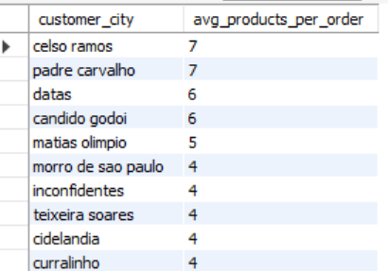
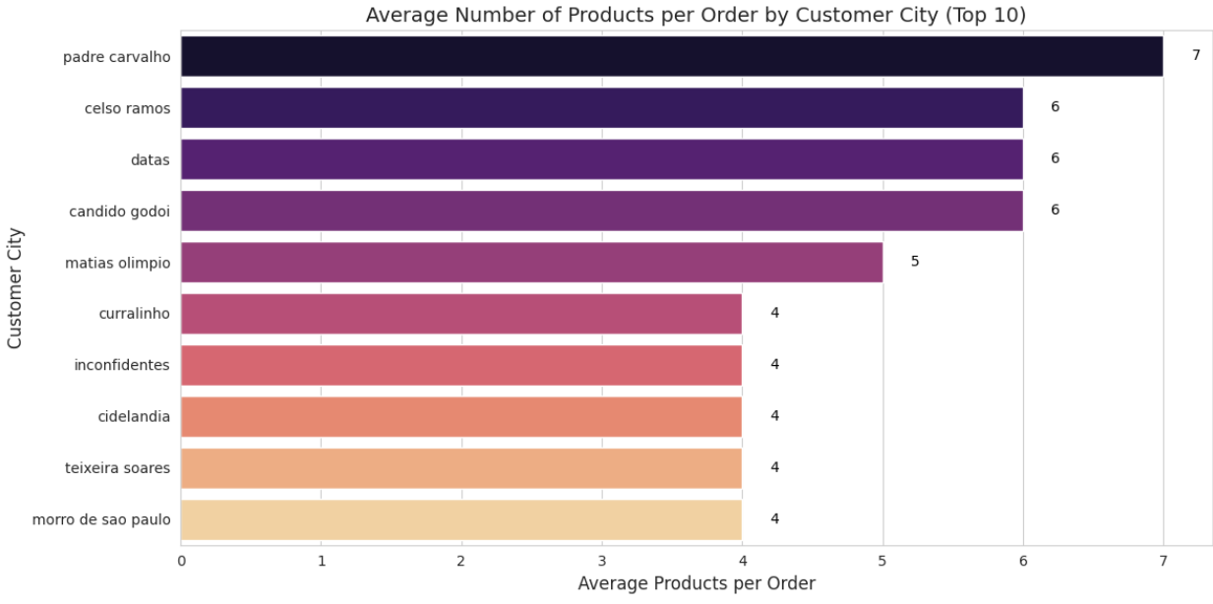
Q7. Average Number of Products per Order by City
SQL Query:
WITH items_per_order AS (SELECT order_id,COUNT(order_item_id) AS items_count
FROM order_items
GROUP BY order_id)
SELECT c.customer_city, ROUND(AVG(ipo.items_count), 0) AS avg_products_per_order
FROM orders o
JOIN customers c ON o.customer_id = c.customer_id
JOIN items_per_order ipo ON o.order_id = ipo.order_id
GROUP BY c.customer_city
ORDER BY avg_products_per_order DESC;
Output
Python Code:
items_per_order = (order_items.groupby('order_id')['order_item_id'].count().reset_index())
items_per_order.columns = ['order_id', 'items_count’]
merged_data = (orders[['order_id', 'customer_id']].merge(customers[['customer_id', 'customer_city']],
on='customer_id', how='left').merge(items_per_order, on='order_id', how='left'))
avg_products_per_city = (merged_data.groupby('customer_city')['items_count'].mean().reset_index())
avg_products_per_city.columns = ['City', 'Avg_Products_per_Order']
avg_products_per_city['Avg_Products_per_Order'] = avg_products_per_city['Avg_Products_per_Order'].round(0)
top_cities = avg_products_per_city.sort_values(by='Avg_Products_per_Order', ascending=False).head(10)
plt.figure(figsize=(12, 6))
ax = sns.barplot(x='Avg_Products_per_Order', y='City', data=top_cities, palette='magma')
plt.title('Average Number of Products per Order by Customer City (Top 10)', fontsize=14)
plt.xlabel('Average Products per Order', fontsize=12)
plt.ylabel('Customer City', fontsize=12)
for i, value in enumerate(top_cities['Avg_Products_per_Order']):
ax.text(value + 0.2, i, f"{int(value)}", va='center', fontsize=10, color='black')
plt.tight_layout()
plt.show()
Output
Insight: Larger metropolitan cities have higher average products per order, indicating more diverse purchases.

Slide 12
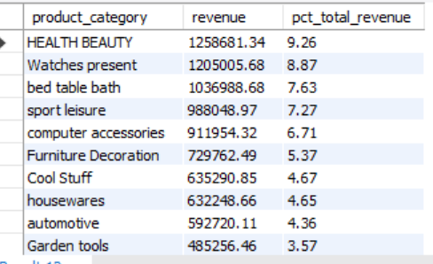
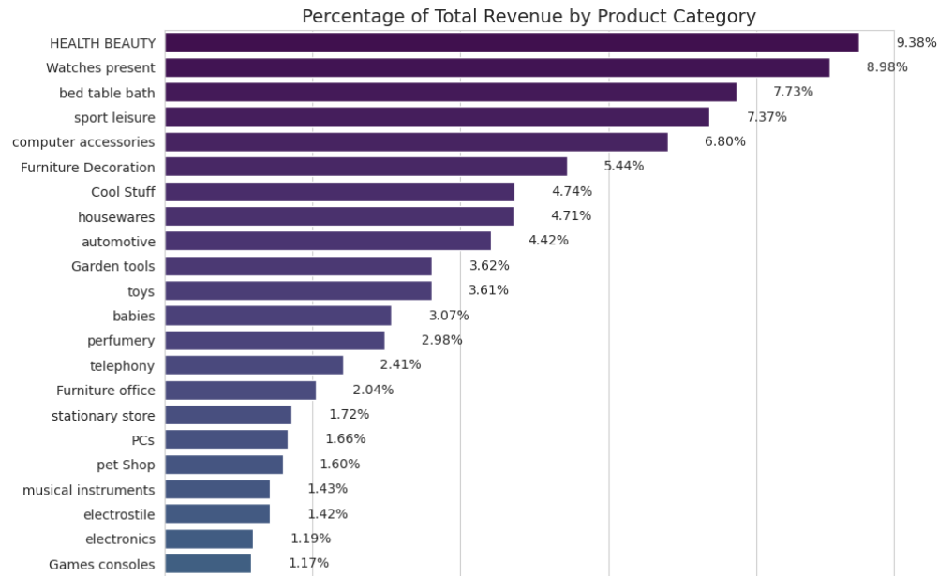
Q8. Percentage of Total Revenue by Product Category
SQL Query:
WITH revenue_by_category AS (
SELECT p.product_category, SUM(oi.price) AS rev
FROM order_items oi
JOIN products p ON oi.product_id = p.product_id
GROUP BY p.product_category)
SELECT product_category,
ROUND(rev,2) AS revenue,
ROUND(100 * rev / (SELECT SUM(rev)
FROM revenue_by_category), 2)
AS pct_total_revenueFROM revenue_by_category
ORDER BY rev DESC;
Output
Python Code:
merged = order_items.merge(products, on='product_id', how='left')
revenue_category = merged.groupby('product category')['price'].sum().reset_index()
revenue_category['Revenue_Pct'] = 100 * revenue_category['price'] / revenue_category['price'].sum()
revenue_category = revenue_category.sort_values('Revenue_Pct', ascending=True)
plt.figure(figsize=(10,25))
ax = sns.barplot(x='Revenue_Pct', y='product category', data=revenue_category, palette='viridis')
plt.title('Percentage of Total Revenue by Product Category', fontsize=14)
plt.xlabel('Revenue Contribution (%)', fontsize=12)
plt.ylabel('Product Category', fontsize=12)
for i, row in enumerate(revenue_category['Revenue_Pct']):
ax.text(row + 0.5, i, f"{row:.2f}%", va='center', fontsize=10)
plt.show()
Output
Insight: Health Beauty categories contribute more than 9% of the total revenue.

Slide 13
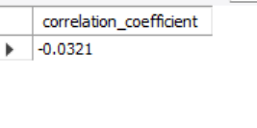
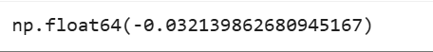
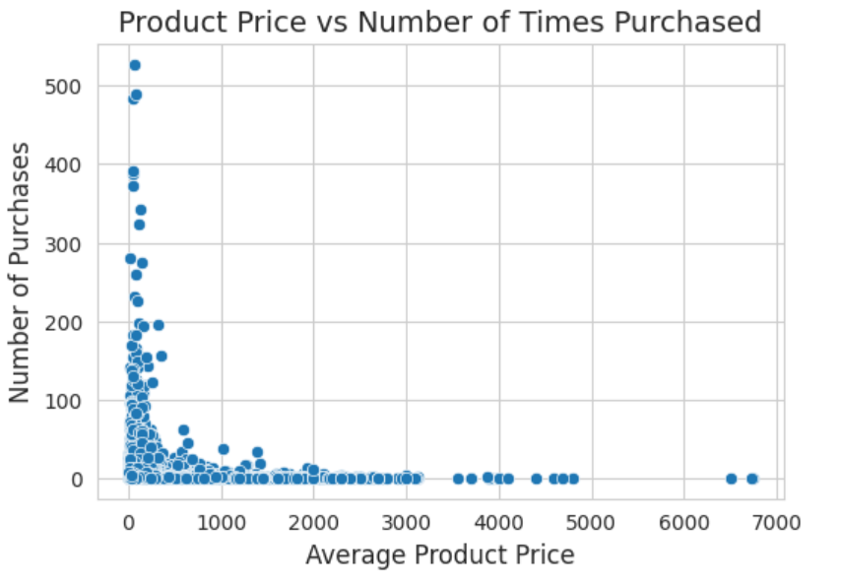
Q9. Correlation Between Price and Purchase Count
SQL Query:
WITH product_stats AS (SELECT oi.product_id, AVG(oi.price) AS avg_price,COUNT(*) AS times_sold
FROM order_items oi
GROUP BY oi.product_id)SELECT ROUND((SUM((avg_price - (SELECT AVG(avg_price)
FROM product_stats)) *
(times_sold - (SELECT AVG(times_sold) FROM product_stats))) /
SQRT(SUM(POW(avg_price - (SELECT AVG(avg_price)
FROM product_stats), 2)) *
SUM(POW(times_sold - (SELECT AVG(times_sold)
FROM product_stats), 2)))), 4) AS correlation_coefficient
FROM product_stats;
Output
Python Code:
product_sales = order_items.groupby('product_id').agg(avg_price=('price', 'mean'),
times_purchased=('order_id', 'count')).reset_index()
correlation = product_sales['avg_price'].corr(product_sales['times_purchased'])correlation
Output
product_sales = order_items.groupby('product_id').agg({'price':'mean','order_item_id':'count'}).reset_index()
product_sales.columns = ['Product_ID','Avg_Price','Num_Purchased']
plt.figure(figsize=(6,6))
ax = sns.scatterplot(x='Avg_Price', y='Num_Purchased', data=product_sales)
plt.title('Product Price vs Number of Times Purchased', fontsize=14)
plt.xlabel('Average Product Price', fontsize=12)
plt.ylabel('Number of Purchases', fontsize=12)
plt.show()
Output
Insight: Products with moderate pricing tend to have higher purchase counts, showing a mid-range demand peak, Correlation value is -0.03.

Slide 14
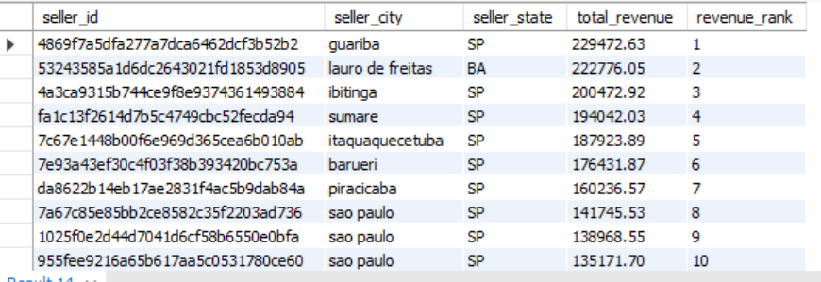
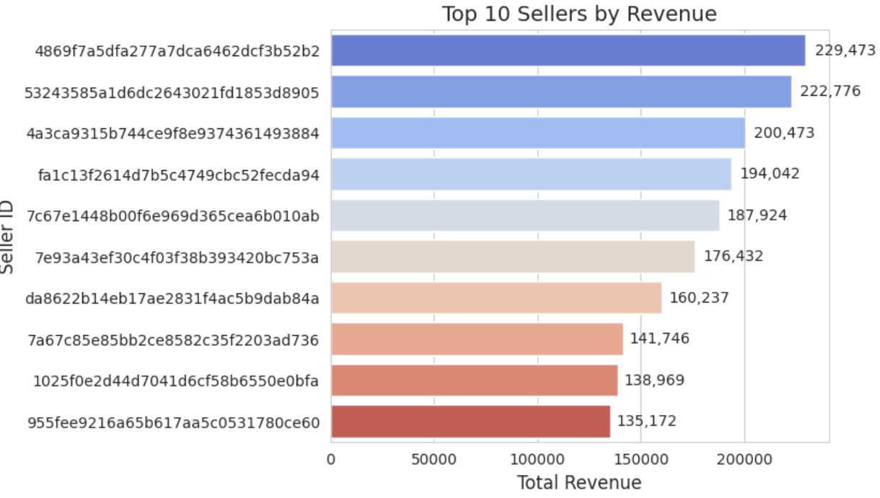
Q10. Total Revenue by Seller (Ranked)
SQL Query:
SELECT s.seller_id, s.seller_city, s.seller_state,
ROUND(SUM(oi.price),2) AS total_revenue,
RANK() OVER (ORDER BY SUM(oi.price) DESC) AS revenue_rank
FROM order_items oi
JOIN sellers s ON oi.seller_id = s.seller_id
GROUP BY s.seller_id, s.seller_city, s.seller_state
ORDER BY total_revenue DESC;
Output
Python Code:
seller_revenue = order_items.groupby('seller_id')['price'].sum().reset_index()
seller_revenue = seller_revenue.sort_values('price', ascending=False)
plt.figure(figsize=(6,5))
ax = sns.barplot(x='price', y='seller_id', data=seller_revenue.head(10), palette='coolwarm')
plt.title('Top 10 Sellers by Revenue', fontsize=14)
plt.xlabel('Total Revenue (USD)', fontsize=12)
plt.ylabel('Seller ID', fontsize=12)
for i, row in enumerate(seller_revenue.head(10)['price']):
ax.text(row + 0.02*row, i, f"{row:,.0f}", va='center', fontsize=10)
plt.show()
Output
Insight: A few top sellers dominate total sales volume, with highest revenue by seller is 229,473, indicating concentrated seller performance

Slide 15
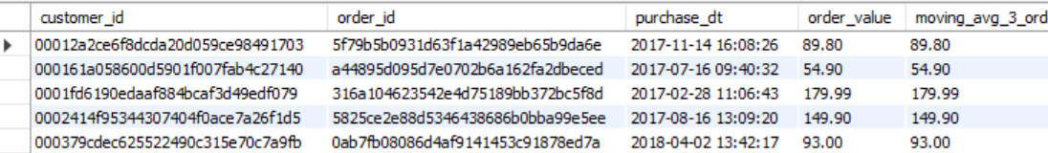
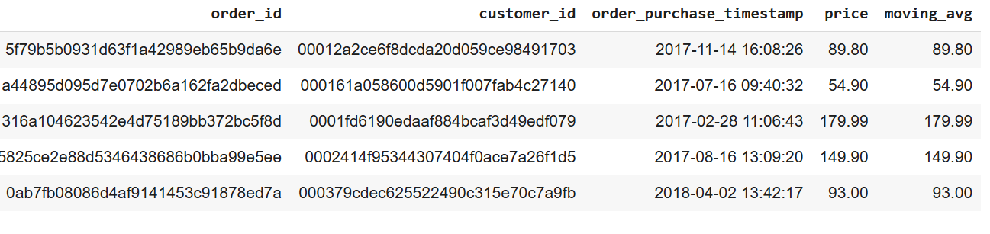
Q11. Moving Average of Order Values per Customer
SQL Query:
WITH order_values AS ( SELECT o.order_id, o.customer_id, SUM(oi.price) AS order_value,
STR_TO_DATE(o.order_purchase_timestamp, '%Y-%m-%d %H:%i:%s') AS purchase_dt
FROM orders o
JOIN order_items oi ON o.order_id = oi.order_id
GROUP BY o.order_id, o.customer_id, purchase_dt)
SELECT customer_id, order_id, purchase_dt, order_value, ROUND(AVG(order_value) OVER (PARTITION BY customer_id
ORDER BY purchase_dt ROWS BETWEEN 2 PRECEDING AND CURRENT ROW),2) AS moving_avg_3_orders
FROM order_values
ORDER BY customer_id, purchase_dt;
Output
Python Code:
order_totals = order_items.groupby('order_id')['price'].sum().reset_index()
orders_ma = orders[['order_id', 'customer_id', 'order_purchase_timestamp']].merge(order_totals, on='order_id', how='left')
orders_ma = orders_ma.sort_values(['customer_id', 'order_purchase_timestamp'])
orders_ma['moving_avg'] = orders_ma.groupby('customer_id')['price'].transform(lambda x: x.rolling(3, min_periods=1).mean())
orders_ma.head(5)
Output
Insight: Moving averages show stable purchasing behavior with gradual increase over time.

Slide 16
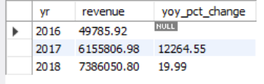
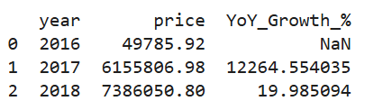
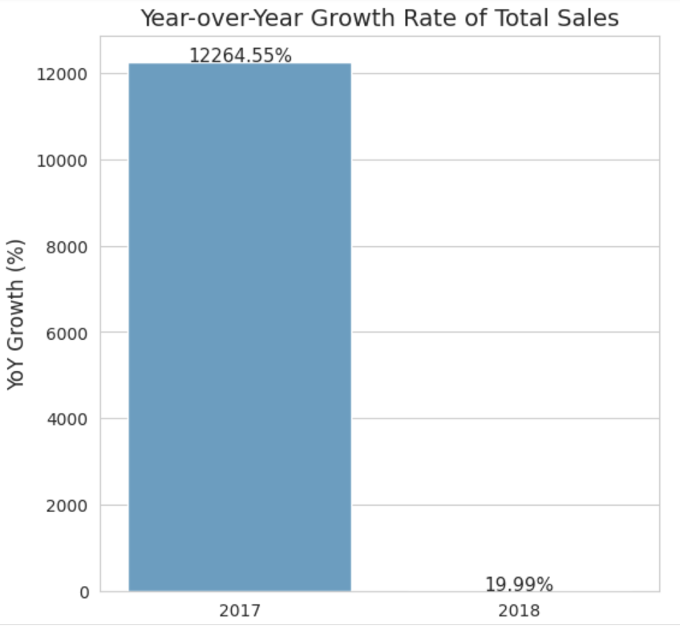
Q13. Year-over-Year Growth Rate
SQL Query:
WITH annual AS (
SELECT YEAR(STR_TO_DATE(order_purchase_timestamp, '%Y-%m-%d %H:%i:%s’))
AS yr,SUM(oi.price) AS revenue
FROM orders o
JOIN order_items oi ON o.order_id = oi.order_id
GROUP BY yr)SELECT yr, revenue,ROUND(100 * (revenue - LAG(revenue) OVER (ORDER BY yr)) / LAG(revenue) OVER (ORDER BY yr), 2) AS yoy_pct_change
FROM annual
ORDER BY yr;
Output
Python Code:
merged_orders = orders.merge(order_items, on='order_id', how='left')
merged_orders['order_purchase_timestamp'] = pd.to_datetime(merged_orders['order_purchase_timestamp'], errors='coerce')
merged_orders['year'] = merged_orders['order_purchase_timestamp'].dt.year
yearly_sales = merged_orders.groupby('year')['price'].sum().reset_index()
yearly_sales['YoY_Growth_%'] = yearly_sales['price'].pct_change() * 100
print(yearly_sales)
plot_data = yearly_sales[yearly_sales['year'] >= 2017]
plt.figure(figsize=(6,6))
ax = sns.barplot(x='year', y='YoY_Growth_%', data=plot_data, palette='Blues_d')
plt.title('Year-over-Year Growth Rate of Total Sales', fontsize=14)
plt.xlabel('Year', fontsize=12)
plt.ylabel('YoY Growth (%)', fontsize=12)
for i, row in plot_data.iterrows():
ax.text(row['year']-2017, row['YoY_Growth_%'] + 0.5, f"{row['YoY_Growth_%']:.2f}%", ha='center', fontsize=11)
plt.show()
Output
Output
Insight: Strong growth observed in 2017 and 2018, reflecting market expansion.

Slide 17
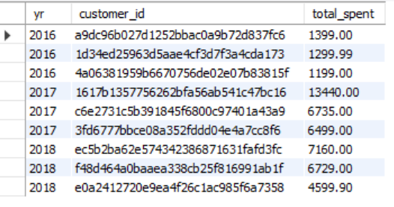
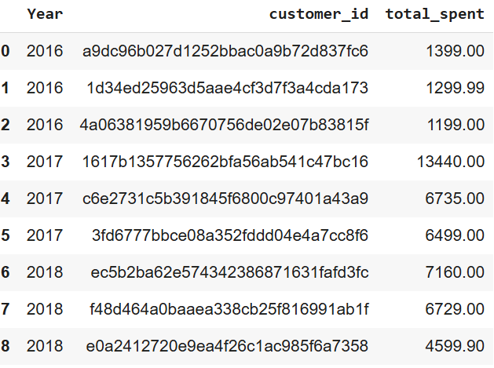
Q14. Top 3 customers who spent the most money in each year
SQL Query:
WITH cust_yearly AS (SELECT o.customer_id, YEAR(STR_TO_DATE(o.order_purchase_timestamp, '%Y-%m-%d %H:%i:%s')) AS yr, SUM(oi.price) AS total_spent
FROM orders o
JOIN order_items oi ON o.order_id = oi.order_id
GROUP BY o.customer_id, yr)SELECT yr, customer_id, total_spent
FROM (SELECT cy.*, ROW_NUMBER() OVER (PARTITION BY yr
ORDER BY total_spent DESC) AS rn
FROM cust_yearly cy) t
WHERE rn <= 3ORDER BY yr, total_spent;
Output
Python Code:
order_totals = order_items.groupby('order_id')['price'].sum().reset_index()
merged_data = orders.merge(order_totals, on='order_id', how='left')
merged_data['Year'] = pd.to_datetime(merged_data['order_purchase_timestamp']).dt.year
yearly_spending = (
merged_data.groupby(['Year', 'customer_id'])['price']
.sum()
.reset_index())
yearly_spending.columns = ['Year', 'customer_id', 'total_spent']
top3_customers = (
yearly_spending.groupby('Year')
.apply(lambda x: x.nlargest(3, 'total_spent'))
.reset_index(drop=True))
top3_customers = top3_customers.sort_values(by=‘Year', ascending=True).reset_index(drop=True)
top3_customers
Output
Insights:The top-spending customers vary each year, showing that high-value buyers are not consistent across years.

Slide 18
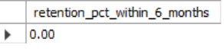
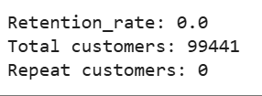
Q15. Customer retention rate:%customers who make another purchase within 6 months of their first purchase
SQL Query:
WITH cust_first AS (SELECT customer_id,
MIN(STR_TO_DATE(order_purchase_timestamp, '%Y-%m-%d %H:%i:%s')) AS first_purchase FROM orders
GROUP BY customer_id),cust_next AS ( SELECT o.customer_id, MIN(STR_TO_DATE(o.order_purchase_timestamp, '%Y-%m-%d %H:%i:%s')) AS next_purchase FROM orders o
JOIN cust_first cf ON o.customer_id = cf.customer_id
WHERE STR_TO_DATE(o.order_purchase_timestamp, '%Y-%m-%d %H:%i:%s') > cf.first_purchase
GROUP BY o.customer_id)
SELECT ROUND(100 * SUM(CASE WHEN TIMESTAMPDIFF(MONTH, cf.first_purchase, cn.next_purchase) <= 6 THEN 1 ELSE 0 END) / COUNT(*), 2) AS retention_pct_within_6_months
FROM cust_first cf
LEFT JOIN cust_next cn ON cf.customer_id = cn.customer_id;
Output
Python Code:
orders['order_purchase_timestamp'] = pd.to_datetime(orders['order_purchase_timestamp'], errors='coerce')
if 'first_purchase' in orders.columns:
orders = orders.drop(columns=['first_purchase'])
first_purchase = orders.groupby('customer_id')['order_purchase_timestamp'].min().reset_index()
first_purchase.columns = ['customer_id', 'first_purchase']
orders = orders.merge(first_purchase, on='customer_id', how='left')
repeat_purchases = orders[orders['order_purchase_timestamp'] > orders['first_purchase']].copy()
repeat_purchases['month_diff'] = ((repeat_purchases['order_purchase_timestamp'] - repeat_purchases['first_purchase']).dt.days // 30)
retained_customers = repeat_purchases[repeat_purchases['month_diff'] <= 6]['customer_id'].nunique()
total_customers = first_purchase['customer_id'].nunique()
retention_rate = round(retained_customers / total_customers * 100, 2)
print("Retention_rate:", retention_rate)
print("Total customers:", total_customers)
print("Repeat customers:", retained_customers)
Output
Insight: No customers made a repeat purchase within 6 months of their first order, indicating low short-term loyalty. This suggests the company should focus on customer engagement, loyalty programs, and post-purchase communication.

Slide 19
2018 Monthly Trends & Customer Behaviour
01
Monthly Order Patterns
Order volume fluctuations throughout 2018 reveal seasonal trends and peak shopping periods, essential for inventory planning and resource allocation.
02
City-Level Analysis
Top 20 cities by average products per order showcase metropolitan areas driving higher basket values and premium purchasing behaviour.
03
Revenue Distribution
Percentage revenue contribution by product category highlights strategic focus areas for marketing investment and supplier partnerships.
04
Price Sensitivity
Scatter plot analysis of price versus purchase frequency reveals optimal pricing strategies and customer value perception patterns.

Slide 20
Advanced Analytics Deep Dive
Sophisticated analytical techniques reveal patterns beyond surface-level metrics, providing strategic foresight for business growth.
1
2
Customer Value Trajectory
Year-over-Year Growth
Moving average analysis of order values across sample customers demonstrates purchasing evolution over time, identifying high-value customer segments and growth opportunities.
Sales growth comparison reveals acceleration trends, highlighting successful strategies and areas requiring adjustment for sustained expansion.
3
Retention Metrics
Six-month customer retention analysis provides critical insights into loyalty programmes effectiveness and customer satisfaction levels.

Slide 21



Tools & Methodology
SQL/MySQL
Python Analytics
Google Colab
Robust data extraction, complex aggregations, and sophisticated calculations form the foundation of our analysis pipeline.
Leveraging Pandas, Seaborn, and Matplotlib for advanced statistical analysis and compelling data visualisation.
Interactive notebooks enable collaborative analysis, reproducible research, and seamless sharing of insights across teams.
Conclusion:
This comprehensive analysis identifies high-revenue categories, quantifies customer retention, ranks seller performance, and uncovers city-level patterns empowering targeted marketing strategies and data-driven inventory planning for sustainable growth.

Slide 22
ThANK YOU
Contacts
E-Mail Id: lopitamishra2001@gmail.com
LinkedIn: https://linkedin.com/in/lopita-mishra-096534191
Portfolio: https://lopita-mishra-portfolio.netlify.app/
GitHub: github.com/Mlopita

